Slide 1
Modal verb
must

Slide 2
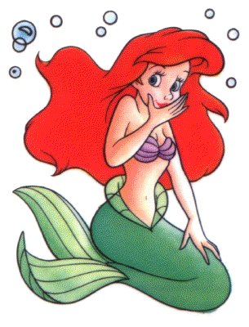
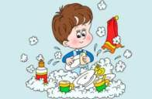
must
Означает: должен.
Например: I must swim. – Я должна плавать. He must help. – Он должен помочь.
После модального глагола must частица to не ставится.

Slide 3
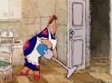



Must утвердительные предложения
1 лицо
2 лицо
3 лицо
He must clean his room
She must clean her room
It must protect our house
You must clean your room
I must clean my room
We must clean our room
You must clean your room
They must clean their room

Slide 4

Must отрицательные предложения
1 лицо
2 лицо
3 лицо
He/she/it mustn’t play with matches
You mustn’t play with matches
I must not play with matches
We mustn’t play with matches
You mustn’t play with matches
They mustn’t play with matches

Slide 5
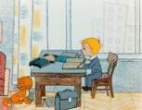
Must вопросительные предложения
1 лицо
2 лицо
3 лицо
Must he/she/it do homework?
Must you do homework?
Must I do homework?
Must we do homework?
Must you do homework?
Must they do homework?

Slide 6
Must краткие ответы
1 лицо
2 лицо
3 лицо
Yes, he/she/it must/
No, he/she/it mustn’t.
Yes, you must/
No, you mustn’t.
Yes, I must/
No, I mustn’t.
Yes, we must/
No, we mustn’t.
Yes, you must/
No, you mustn’t.
Yes, they must/
No, they mustn’t.

Slide 7


Вставь форму must
You … play with a ball in our class.
mustn’t
Must
… you wash the dishes?
She … give her pet food and drink every day.
must
I … sleep on the lesson.
We … hurt animals.
… he walk with his dog every day?

Slide 8
Сделайте предложения отрицательными
not
She mustn’t get up at 7 o’clock.
She must get up at 7 o’clock.
We may not watch TV every evening.
We may watch TV every evening.
He mustn’t go to school at Saturday.
He must go to school at Saturday.
I may not play computer games.
I may play computer games.
They must not go to bed at 10 o’clock.
They must go to bed at 10 o’clock.
You may not take my phone.
You may take my phone.
I cannot dance very well.
I can dance very well.
It can’t eat a bone.
It can eat a bone.

Slide 9

Сделайте предложения вопросительными
May you go for a walk?
You may go for a walk.
Mustn’t we make noise at night?
We mustn’t make noise at night.
Can he skate and ski well?
He can skate and ski well.
Must it sleep on this rug?
It must sleep on this rug.
Can’t she speak English?
She can’t speak English.
May they not go out?
They may not go out.

Slide 10

Переведите
Can you cook a cake?
Ты умеешь готовить торт?
They may watch TV in the evening.
Им разрешают смотреть телевизор вечером.
We mustn’t listen to music at a lesson.
Нам нельзя слушать музыку на уроке.
He can play tennis well.
Он хорошо умеет играть в теннис.
She can play the piano and guitar.
Она умеет играть на пианино и гитаре.
I must clean my room.
Я должен убираться в своей комнате.
May not you play computer games?
Тебе не разрешают играть в компьютерные игры?

Slide 11

Ответьте на вопросы
Can you cook?
May you eat pizza?
Must you brush your teeth every day?
Can your friend ride a bike?
Can’t you drive a car?
Must your mother wake you up every morning?
May you talk on the mobile phone at a lesson?
Mustn’t you read books every day?

