Slide 1
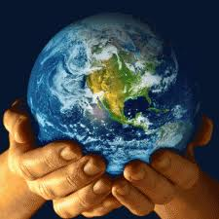
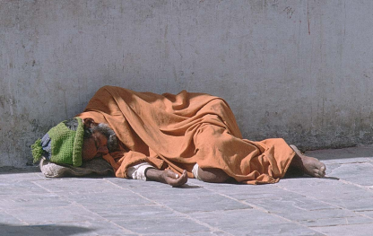
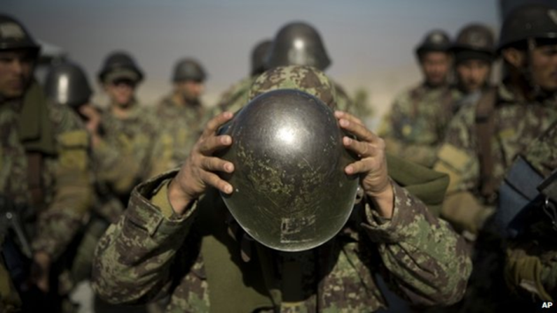
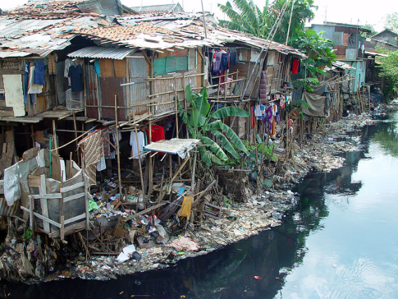
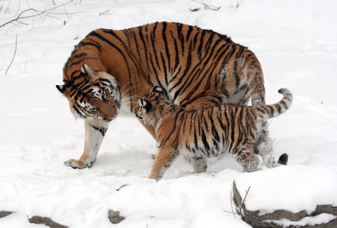
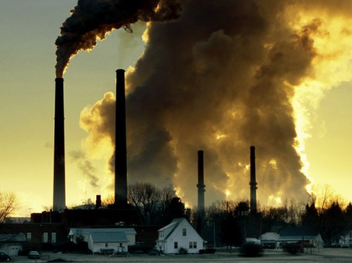
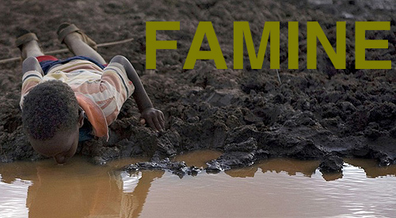
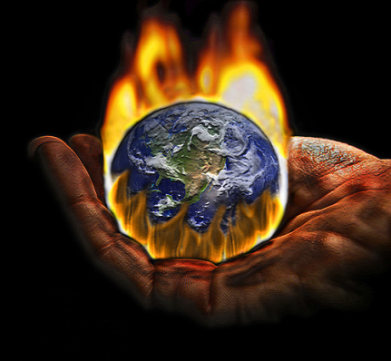
Global Problems

Slide 2
Match the problems with their definitions:
War
Poverty
Famine
Global warming
Endangered species
Pollution
Homelessness
Child labour
a situation in which someone does not have enough money to pay for their basic needs
the slow increase in the temperature of the Earth caused partly by the greenhouse effect
fighting between two or more countries
a serious lack of food
a type of animal or plant that may soon become extinct (=disappear from the world)
the employment of children, especially children who are legally too young to work
without a place to live
the process of damaging the air, water, or land with chemicals

Slide 3
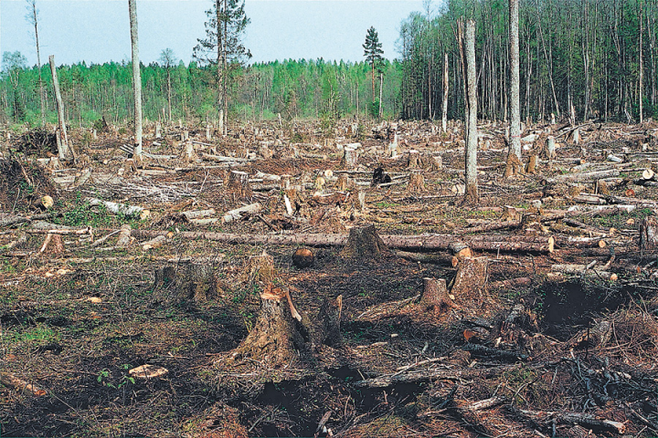
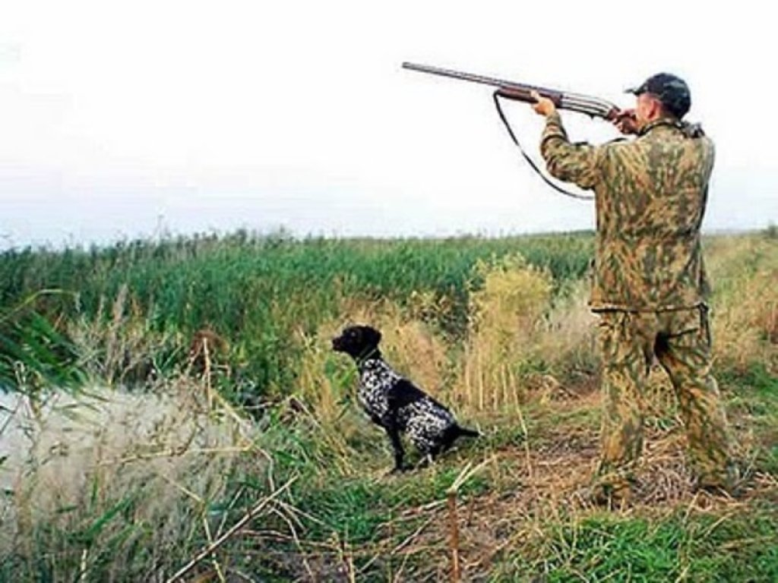
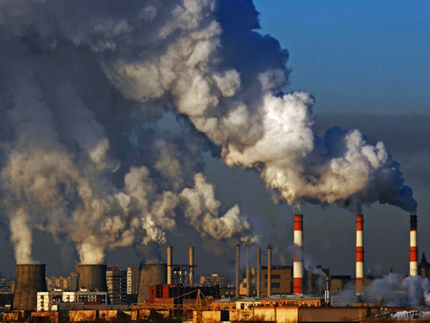
Endangered species. Reasons:
deforestation
hunting
pollution

Slide 4
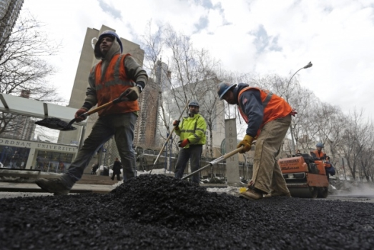


Poverty. Reasons:
Low-paid jobs
unemployment benefits

Slide 5
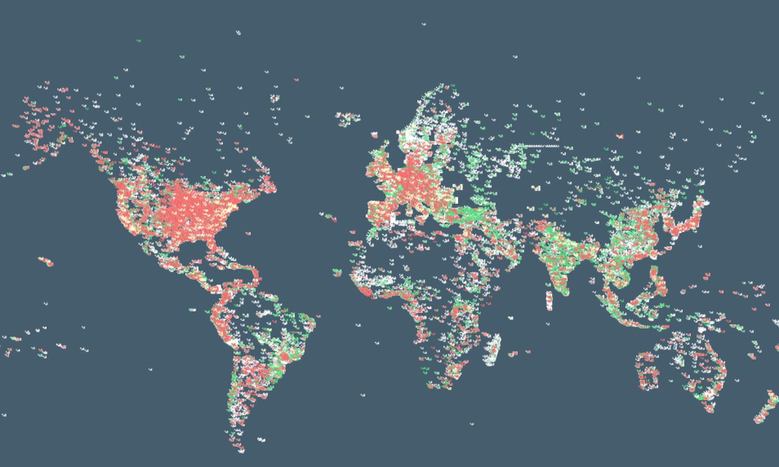
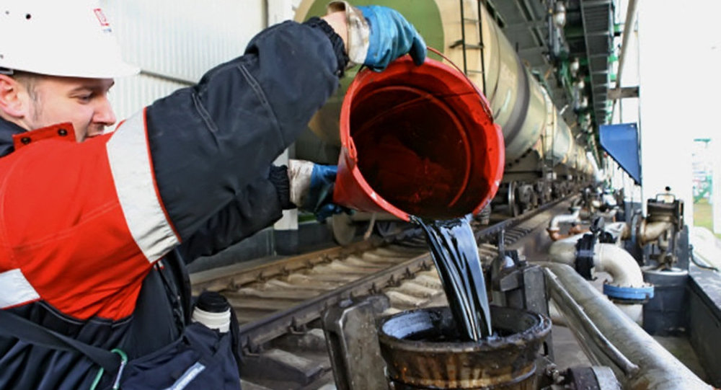

War. Reasons:
World domination
Natural resources
Money

