Slide 1
Present Simple. Простое настоящее время
 | I, you, we, they | he, she, it
+ | I read books. | He reads books.

Slide 2
Present Simple. Простое настоящее время
 | I, you, we, they | he, she, it
- | I don’t read books. | He doesn’t read books.

Slide 3
Present Simple. Простое настоящее время
 | I, you, we, they | he, she, it
? | Do you read books? Yes, I do. No, I don’t. | Does she read books? Yes, she does. No, she doesn’t.

Slide 4
3-rd Person Singular
verb + s
I eat – he eats, I like – she likes
verb (-ss, -sh, -ch, -x, -o) + es
I go – he goes, I wash – she washes
verb (-y) -> ies
I cry – he cries BUT I play – she plays

Slide 5
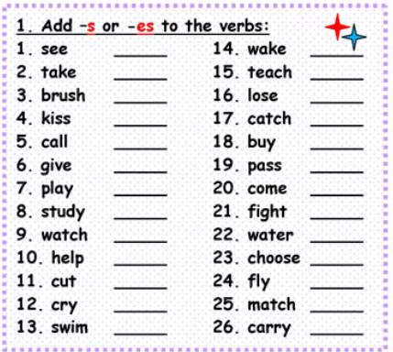

Slide 6
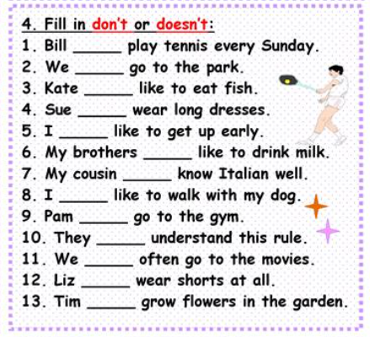

Slide 7


