Slide 1
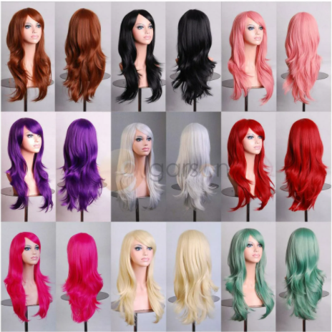
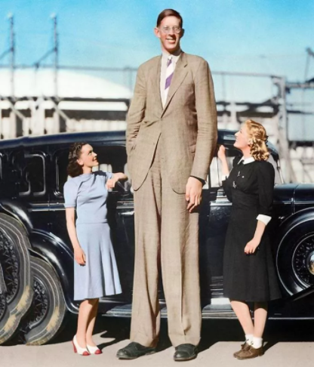
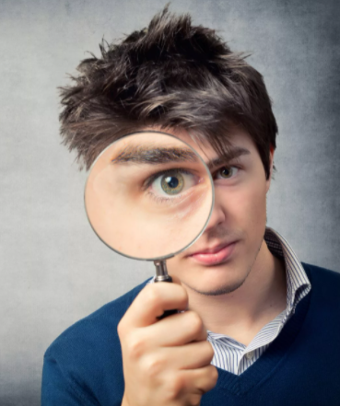
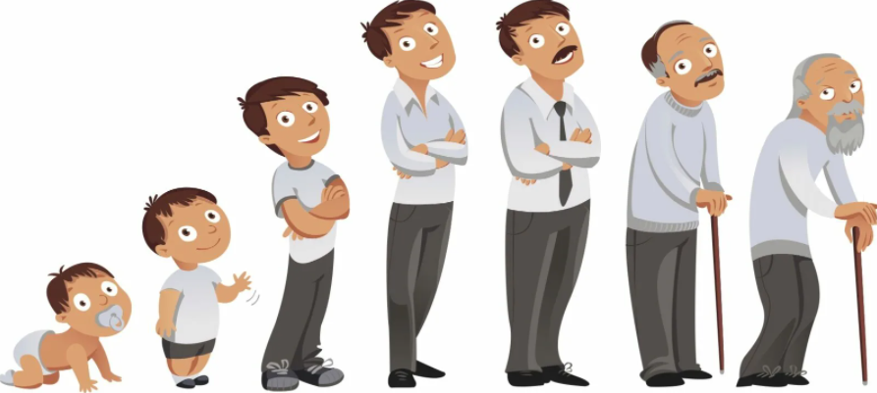
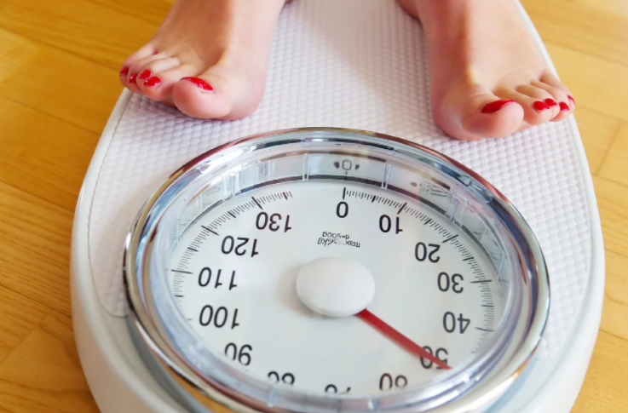
Appearance
age
возраст
hair
волосы
height
рост
weight
вес
facial features
черты лица
age
weight
hair
height
facial features
Guess the word.

Slide 2

Age
Weight
Height
old
старый
fat
толстый
tall
высокий
middle aged
средних лет
slim
худой
short
низкий
young
молодой
Hair
Facial features
short / long
nose, ears, head, eyes, mouth
Короткие/длинные
fair / dark / grey
Большой/
маленький
Светлые/темные/
седые
big / small
straight / wavy
Прямые/волнистые

Slide 3
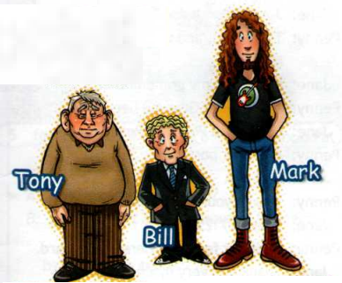
Use the adjectives in bold in Ex. 5 to ask and answer questions about Tony, Bill and Mark.
Is Tony slim?
Are Tony’s eyes big?
Is Mark’s hair long and curly?
Is Bill tall?
What colour are Mark’s boots?
Has Bill got a tie?

Slide 4
Grammar
Possessive adjectives/case
I
He
She
It
We
You
They
my
singular noun + ‘s
‘s
his
Johnny is Janet son.
He’s her son.
her
Plural noun + ‘
its
‘
Bill is the twins brother.
our
He’s their brother.
your
Last noun of a phrase + ‘s
‘s
This is Johnny and Gill dad.
their
He’s their dad.

