Slide 1
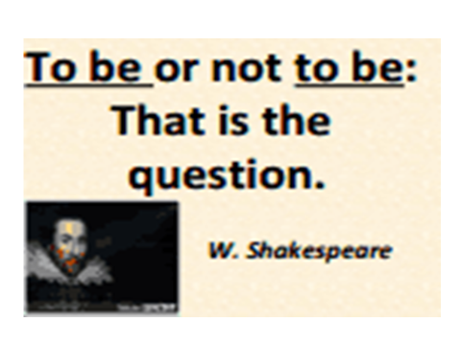

Slide 2
Инфинитив -
неличная форма глагола, которая называет действие, но не указывает ни лица ни числа.
В русском языке отвечает на вопрос что делать?
В английском языке частица to, стоящая перед глаголом, является признаком инфинитива.

Slide 3
Infinitive
Инфинитив с частицей to употребляется:
Для выражения цели:
He uses his car to go to work.
если два инфинитива с частицей to соеденяютс с союзами and/or, частица to второго инфинитива опускается
She went to the haildresser’s to get a haircut and dye her hair
2. После глаголов обозначающих действия относящиеся к будущему:
Agree, appear, decide, expect, hope, plan, promise, refuse, want
They are planning to move to a bigger house.
He has decided to quit hid job.

Slide 4
Infinitive
3. После выражения особого предпочтения
Would like
Would prefer
Would love
I would like to do something different for my birthday this year.
4.После прилагательных обозначающих чувства и эмоции
Happy, glad, sad
Выражающие желание, нежелание
Eager, reluctant, willing
Описывающих характер человека
Clever, polite
Прилагательные
Lucky, fortunate
Jane is always willing to offer her help to those who need it.
С прилагательными, описывающими характер поступка, также используется безличные конструкции
It was kind of them to let us stay in their house

Slide 5
Infinitive
5. После too, enough
Sean didn’t study enough to pass his history test.
Псле словосочетания be+first/second/next/
last
Neil Armstrong was the first man to step on the moon.
6. В устойчивых выражениях
To tell you the truth, to be honest, to sum up, to begin with
I don’t really like her cooking, to tell you the truth

Slide 6
Инфинитив без частицы to
1. После модальных глаголов
Angela can type very fast
После глаголов
Let, make, see, hear, feel
They wan’t let Gergia go to the party
НО! Be made, be heard, be seen в страдательном залоге употребляется to
He was made to clean up the mess he had created.
2. После had better and would rather - в значении «лучше бы»
Tom would rather take the bus when he goes to the city centre
3. После глагола help может употребляться как инфинитив с частицей to, так и без нее.

Slide 7
Put the verbs in brackets into infinitive (with or without to)
He promised (come) in time.
Your tea is too hot (drink).
Don’t let your son (come) home late.
I see him (park) the car.
George would like (visit) Thailand one day
Let me (help) you with that heavy suitcase
Let me (introduce) myself.
You shouldn’t (laugh) at his mistakes.
I’ve decided (start) a new project.
She is trying (learn) Italian
Can you (lend) me your dictionary, please?
You shouldn’t (argue) with your father.
What are you planning (eat) for lunch?
That old car may not (cost) much.
Father won’t let us (play) in the street.

Slide 8
Put the verbs in brackets into infinitive (with or without to)
He was made (pay) for the damage.
You had better (go) to bed.
At last he was made (write) a letter to his parents.
I would love (come) but I’m busy now.
I would prefer (drink) something hot. It’s cold outside.
That restaurant was good enough (visit) it.
I knew how (help) him.
I would rather (go) to bed.
We can’t let him (stay) outdoors.
Children were allowed (go) to the cinema alone
Don’t let him (drive) so fast.
It is very nice of Matt (have) come to us
Well, (cut) a long story short, the party was awful.
It’s too cold outside (go) jogging
Jack is the last (sign) this petition.

Slide 9
Put the verbs in brackets into infinitive (with or without to)
You are very kind (say) so.
It’s kind of you (say) so.
How kind of you (say) so!
I will be happy (accept) your invitation.
I was lucky (get) this job
I knew how (help) him.
They were sorry not (see) you at the meeting.
We were impatient (start).
She was eager to please her parents.
I heard him (fall) from the stairs
Ralph wanted (know) where (buy) some good cheese
I would like (have) a break

