Slide 1
Module 7. Now & then.
7a. In the past

Slide 2

Устно ответь на следующие вопросы.

Slide 3
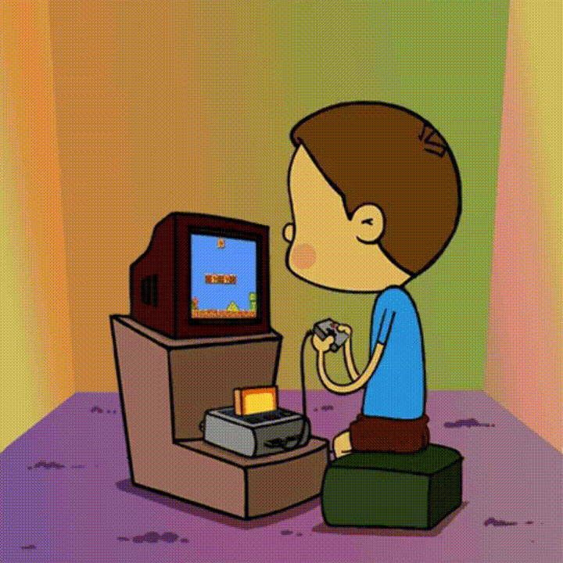
What do you like doing in your free time?

Slide 4
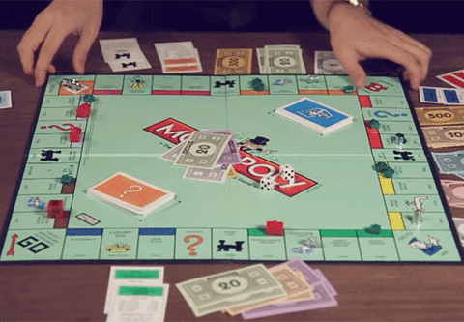
Name some popular board games.
Which is your favorute?

Slide 5
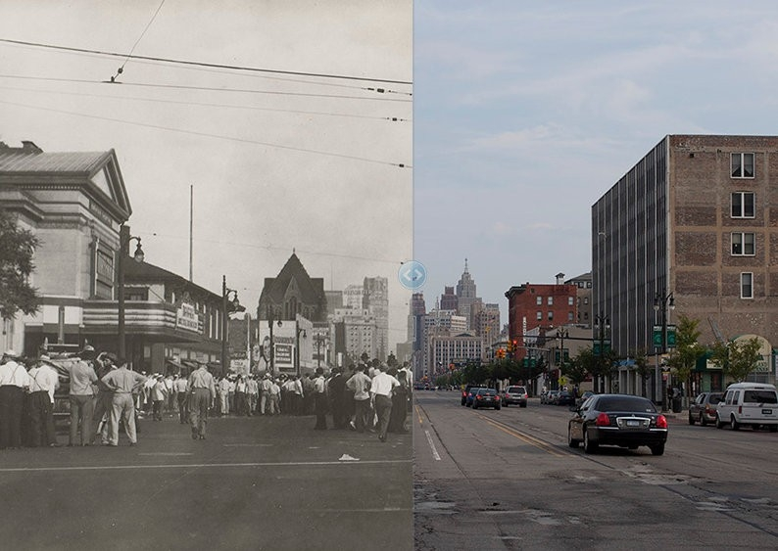
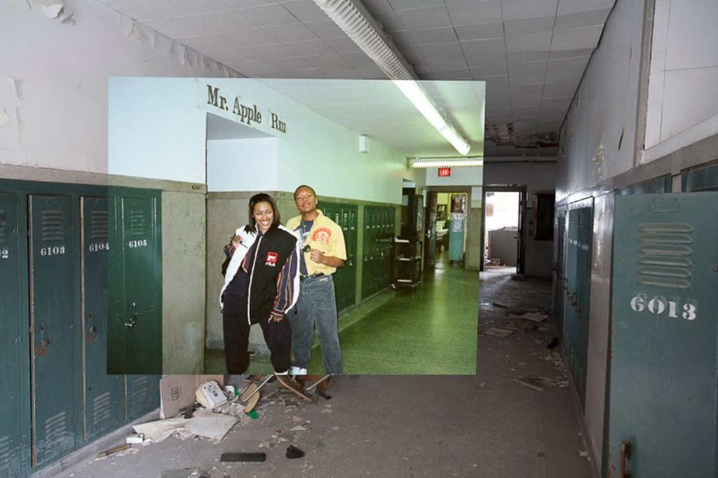
What are we going to talk about?

Slide 6
SB: открой в учебнике раздел ‘Word list’ (в конце учебника) страница WL7, 7a In the past – ознакомься с новой лексикой.

Slide 7
SB: p.66 №1 – match the opposites. (письменно)

Slide 8
Look at the picture at pages 66-67 and answer the following questions. (устно)

Slide 9
What buildings were in this town?
Was this town quiet or busy?
Was this town clean or polluted?
Was this town crowded or deserted?
Was this city beautiful or ugly?

Slide 10
SB: p.66 №3 – прослушай, прочитай и переведи текст (устно).

Slide 11
Найди правильное значение выделенных слов в тексте по следующим слайдам (письменно).

Slide 12
a weekly newspaper
a) a newspaper published once a week
b) a newspaper published every week day

Slide 13
worked in the mines
a) bombs
b) deep holes in the ground that people dig so that they can remove coal, gold …

Slide 14
wealthy
a) rich
b) beautiful

Slide 15
a few ruined building
a) old
b) destroyed

Slide 16
to get an idea
a) to understand
b) to study

