Slide 1
English in Use
Today is the _ of November.
Today is _________.

Slide 2
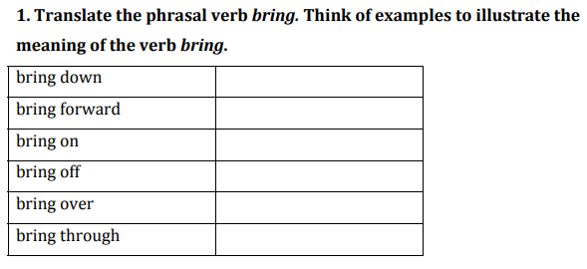
Свалить, сломать
Выдвигать предположение
Навлекать
Спасать
Убедить
Вылечить, помочь

Slide 3
The wind brought down a lot of trees.
Can you bring forward any proofs of what you say?
He has brought all that troubles on himself.
They brought off the passengers of the wrecked ship.
You can’t bring me over by such arguments.
I’m sure the doctor will bring him through.

Slide 4
Фразовый глагол bring
Bring round – приводить в сознание
Bring in – приносить/вносить деньги
Bring up – растить, воспитывать
Bring out – выпускать в продажу
Bring back – напоминать, вспоминать
Bring about – осуществлять
SB p 52 ex 1

Slide 5
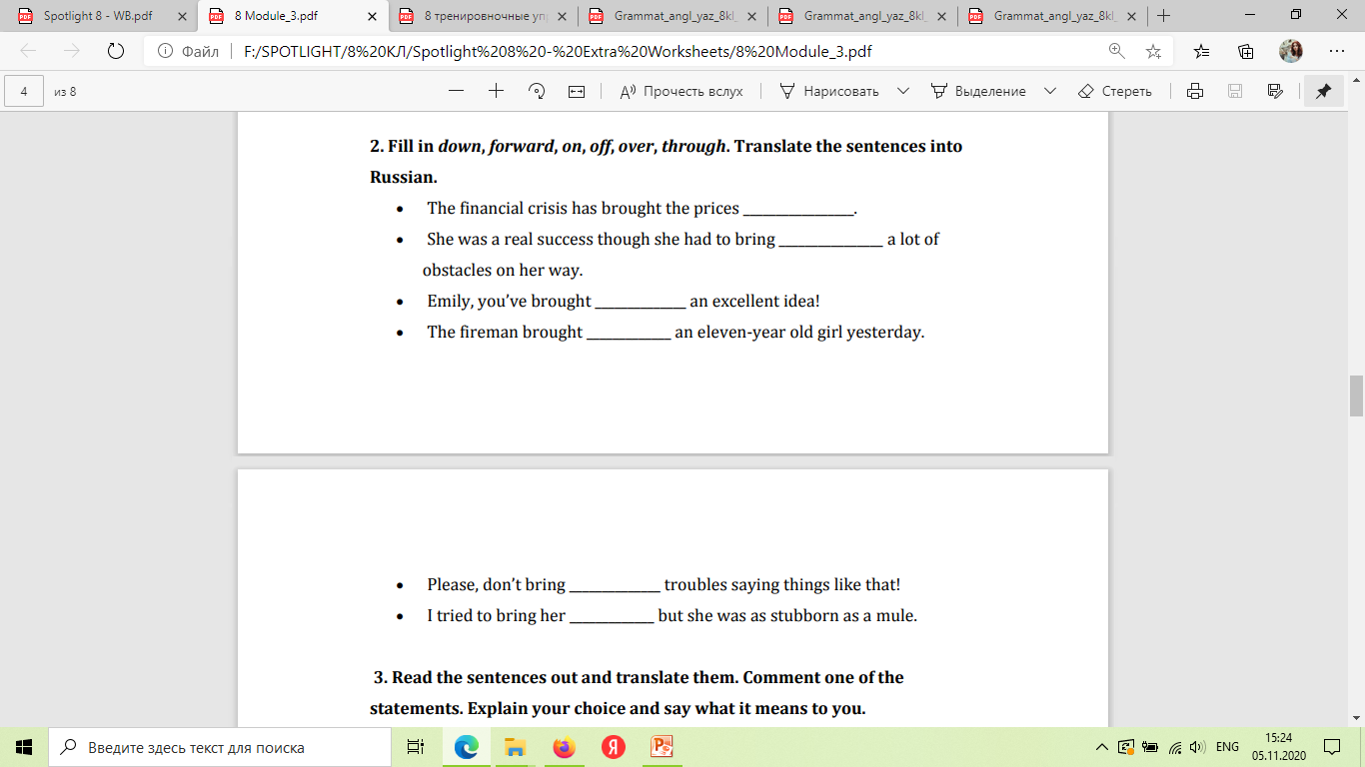

Slide 6
Check yourself:
• The financial crisis has brought the prices down.
• She was a real success though she had to bring through a lot of obstacles
on her way.
• Emily, you’ve brought forward an excellent idea!
• The fireman brought off an eleven‐year‐old girl yesterday.
• Please, don’t bring on troubles saying things like that!
• I tried to bring her over but she was as stubborn as a mule.

Slide 7
Employ – работа по найму
Employee – работающий по найму
Employer – работодатель, наниматель
Employed – работающий
Employable – трудоспособный

Slide 8
StudentBook p 52
Ex 2
Ex 3
Ex 4

Slide 9
Homework
Ссылка на электронную рабочую тетрадь

