Slide 1
Module 4. Day after day.
Lesson 1. Day in, day out.
Today is the _ of November.
Today is ___________.

Slide 2
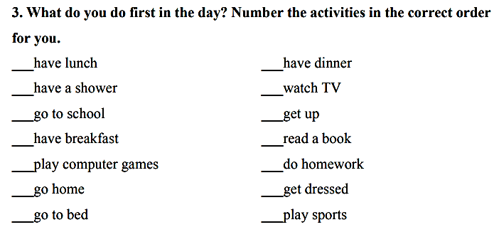

Slide 3
Harry Potter’s daily routine
Hi, everybody! I’m Harry Potter. I’m young magician. I live with the Dursley family and I go to Hogwarts School. When I’m at school, I always have breakfast in the Great Hall. I study a lot of interesting subjects about magic. I study Herbology at the greenhouse twice a week and I study the night skies every Wendesdays at midnight. In my free time, I often play Quidditch and after dinner I meet my friends in the common room and then I sleep in my house dormitory.

Slide 4
Учебник, с 36 упр 2
Ответить на вопросы викторины

Slide 5
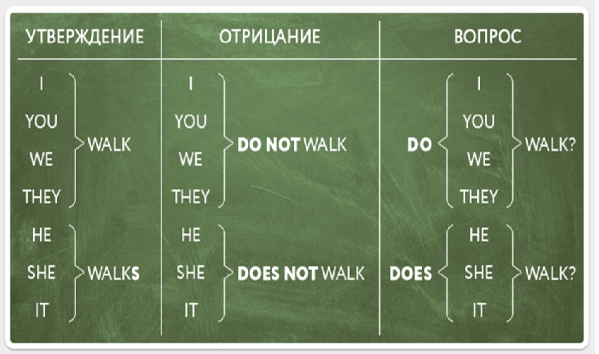
Present Simple

Slide 6
Adverbs of frequency
Always
Usually
Generally
Often
Sometimes
Hardly ever
Rarely/ seldom
Never

Slide 7
Учебник, с 37 упр 4
Поставить глаголы в 3 лицо
(добавить окончание, обращая внимание на правописание)

Slide 8
Учебник, с 37 упр 5
Поставить верную форму глагола

Slide 9
Учебник, с 37 упр 6а) в)
Поставить в правильном порядке слова

Slide 10
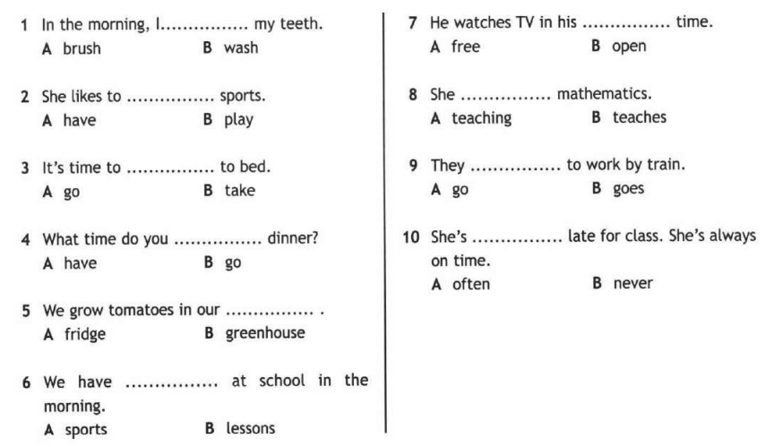
Выбрать верный вариант

Slide 11
Homework
Рабочая тетрадь с 23 упр 2, 3 + дополнительный файл в дневник.ру

