Slide 1
Let’s celebrate

Slide 2
SB p 48 ex 1 a) b)
SB p 49 ex 4

Slide 3
Present Continuous
Отрицание
Вопрос

Slide 4
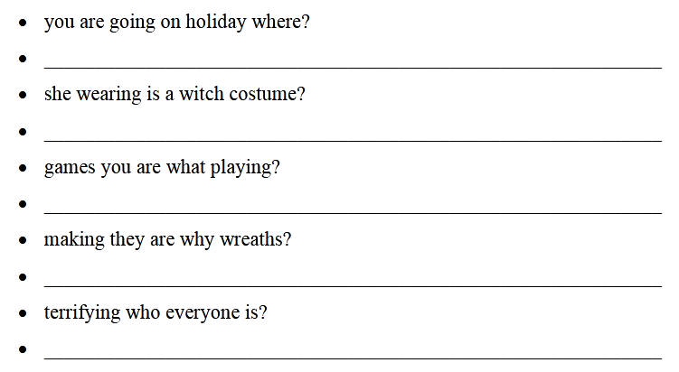
Present Continuous

Slide 5
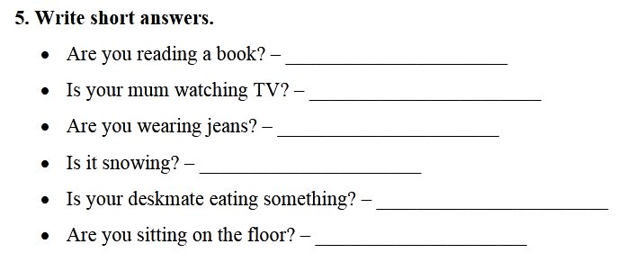

Slide 6
Homework
SB p 48 ex 3a)
WB p 30 ex 1, 2

