Slide 1
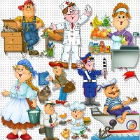
At work!

Slide 2

a doctor

Slide 3
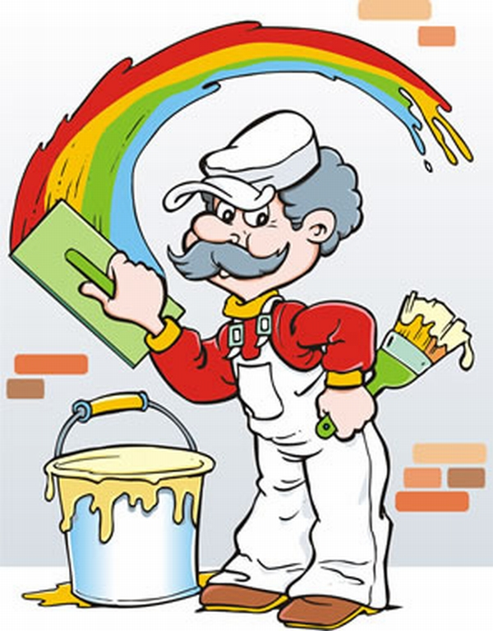
a painter

Slide 4

a nurse

Slide 5
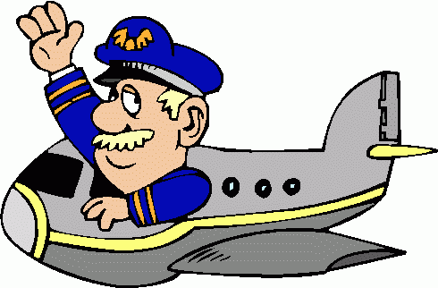
a pilot

Slide 6
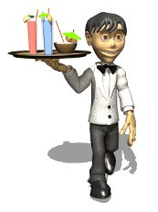
a waiter

Slide 7
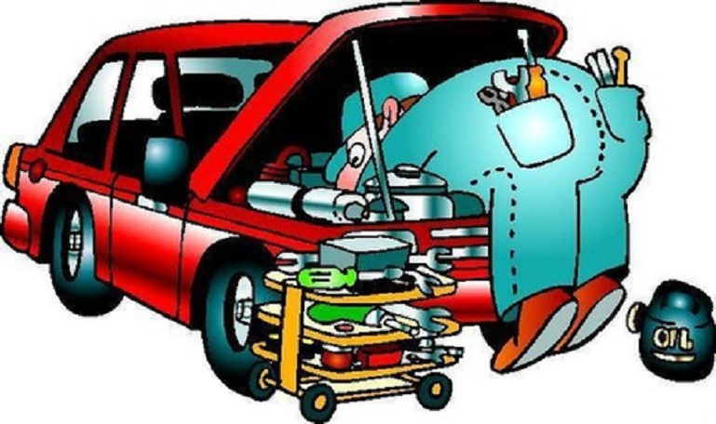
a mechanic

Slide 8
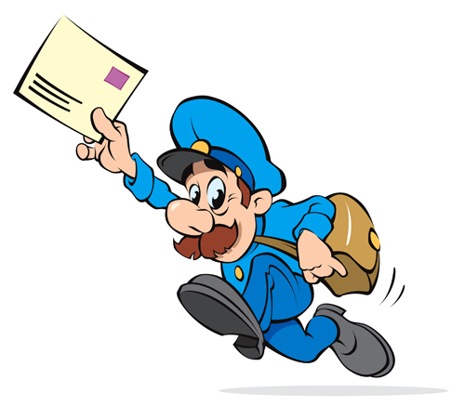
a postman

Slide 9
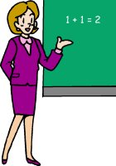
a teacher

Slide 10
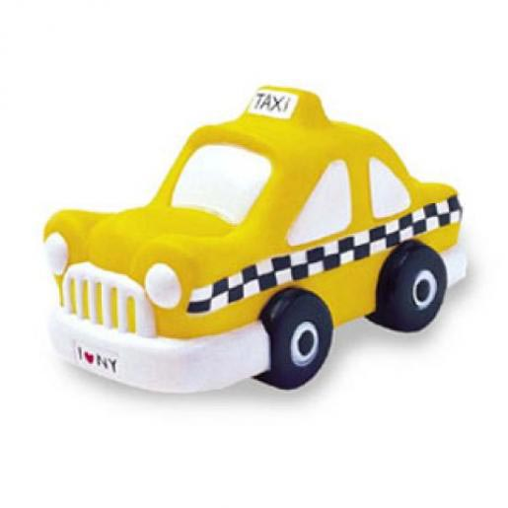
a taxi driver

Slide 11
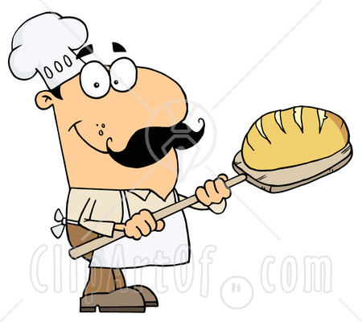
a baker

Slide 12
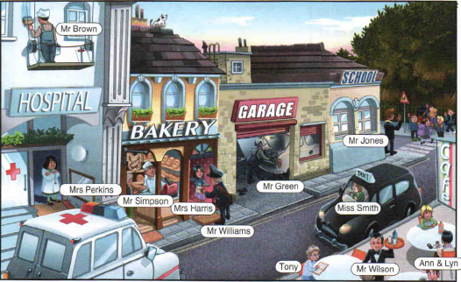
Who is who?

Slide 13
Match!
Baker
Taxi driver
Mechanic
Painter
Postman
Waiter
Paint a hospital
Serve drinks
Repair a car
Deliver a letter
Drive a taxi
Bake a bread

Slide 14
Present Continuous
I am
He
She is
It reading a book now.
You
We are
They

Slide 15
What are they doing now?

Slide 16

Stand up clap clap
Arms up clap clap
Step step arms down
Clap clap please sit down

Slide 17


Slide 18

Homework
Learn words and phrases by heart.

Slide 19

Thank you for the lesson!
Good-bye!

