Slide 1
How about…?
Today is the _ of November.
Today is __________.

Slide 2
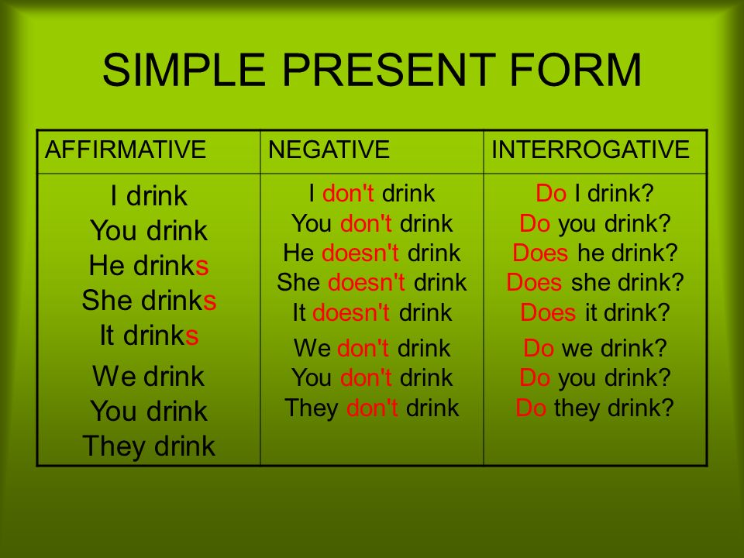

Slide 3
TV-shows
Sitcom
Drama
Music show
News
Sports
Reality show
Science fiction
Talk show
Quiz show
Documentary

Slide 4
Adjectives
Great
Exciting
delicious
Enjoyable
Interesting
Fantastic
Fine
Wonderful
Boring
Awful
Terrible
Disgusting
Dull
Horrible
Bad
Insipid

Slide 5
Учебник, с 39
Читать диалог

Slide 6
Учебник, с 39 упр 6в)

Slide 7
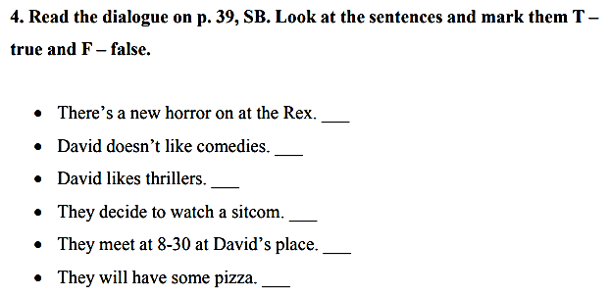

Slide 8
Учебник, с 39 упр 8 а)в)

Slide 9
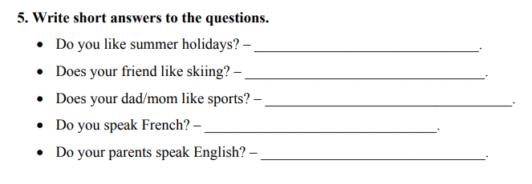

Slide 10
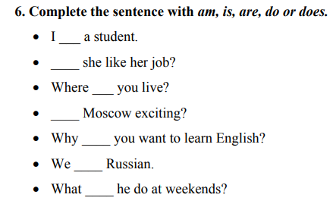

Slide 11
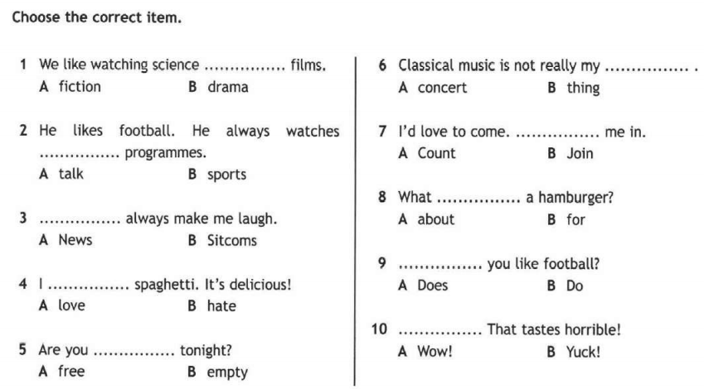

Slide 12
Homework
Рабочая тетрадь с 24 упр 2, 3

