Slide 1
Festive Times

Slide 2

P 46 ex 1a)

Slide 3
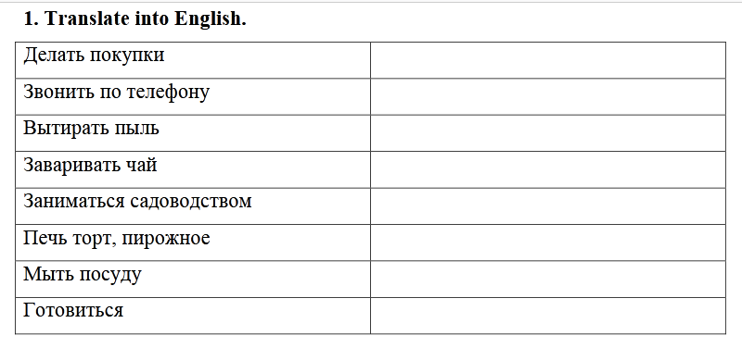

Slide 4
Present Continuous
I
He
She
It
You
We
They
AM
IS
ARE
V _{ing}

Slide 5
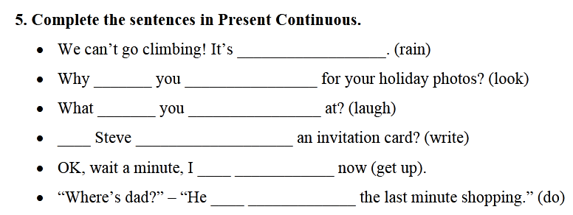

Slide 6
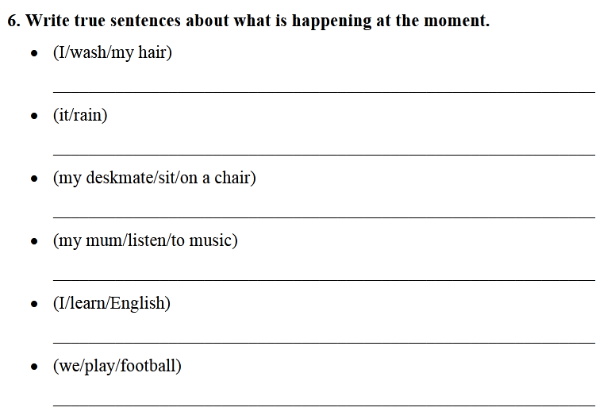

Slide 7
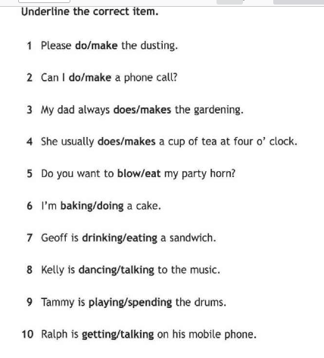

Slide 8
Homework
SB p 46 ex 2b)
WB p 29 ex 1, 3 – in the copybook

