Slide 1
Description of a picture
(Описание картинки)
При описании картинки, прежде всего, важно помнить:
Для описания места используется простое настоящее время (Present Simple), в том числе конструкция местонахождения there is / are; для описания действий людей на картинке – настоящее длительное время (Present Continuous), так как считается, что действия на картинке происходят «в данный момент».
2) Eсли вы говорите о том, что изображено НА картине или фотографии, надо употреблять предлог IN:
- in the picture
- in the photo

Slide 2
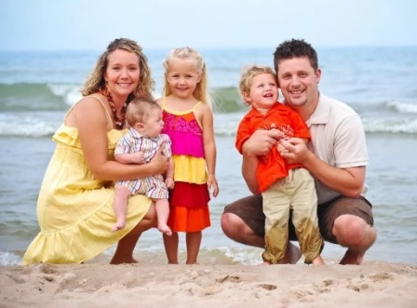
Последовательность описания (пример):
Who the people are;
Where the people are;
What season it is/What the weather is like;
What the people are wearing and doing.
There are four people in the picture. This is a family. They are on the beach. This is summer. The weather is nice, warm and sunny. The woman is wearing a yellow dress. The man is wearing a white shirt and brown shirts. The little boy is wearing a red shirt and light trousers, the girl is wearing a colourful dress, the baby is wearing a striped costume. They are smiling and posing for the photo.

Slide 3

One more example:
Who the people are;
Where the people are;
What the weather is like;
What the people are wearing and doing.
There is a woman in the picture. She is at home, that is why (поэтому) we can’t say what the weather is like. She is wearing a pink blouse and grey trousers. She is reading a book and having a cup of tea.

Slide 4
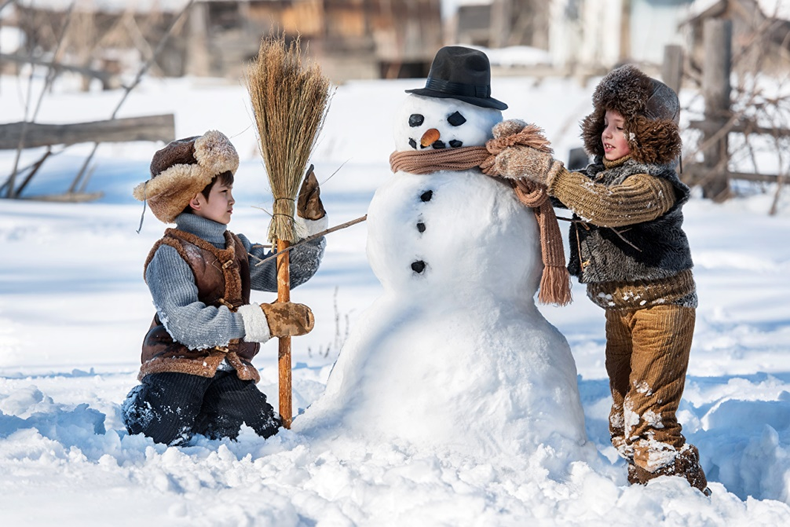

Your task
Задание на оценку: описать две картинки на данном слайде по указанной ранее схеме, используя лексику из учебника (уроки 7a, 7b, 7c).

